Slide 1
DS Lab 2
Mubashra Fayaz & Aqsa Zahid

Slide 2
Google Classroom
um4h765
Email:
mubashra.fayyaz@nu.edu.pk

Slide 3
Today’s Agenda:
Debugging(on dev)
OOP Programming
Dynamic Memory
Dynamic Arrays
Safe Array
Jagged Array
Rule of three
Exercises

Slide 4
Debugging
Using the debugger:
The various features of the debugger are pretty obvious. Click the "Debug" icon to run your program and pause at the current source code cursor location; Click "Next Line" to step through the code; Click "Add Watch" to monitor variables.
Setting breakpoints is as easy as clicking in the blank space (Line Number) next to the line in the source code.

Slide 5
OOP programming
Using Header Files
Header files are used for declaration. In OOP you should use header files to declare classes and functions. It will make your program look more clean and professional.
Header file for a class will include:
Include guards.
Class definition.
Member variables
Function declarations (only prototype)
Implementation File will include:
Include directive for “header.h”
Necessary include directives.
Function definitions for all the functions of the class.

Slide 6
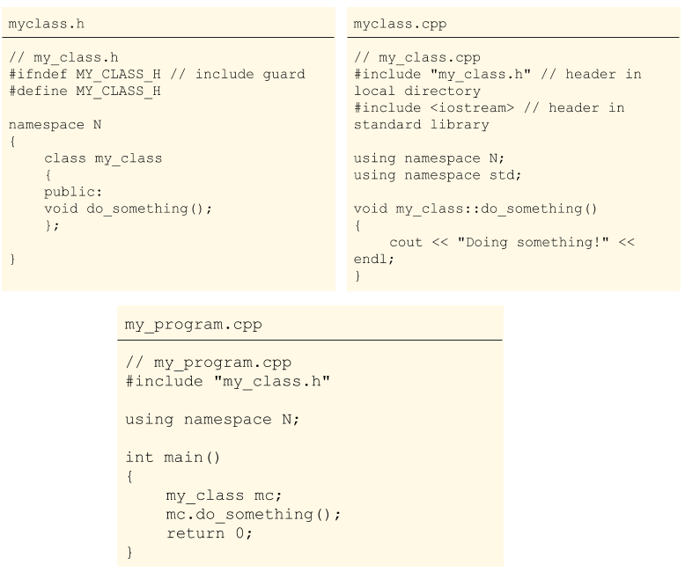
Example

Slide 7
Dynamic memory Allocation
Static memory allocation happens for static and global variables. Memory for these types of variables is allocated once when your program is run and persists throughout the life of your program.
Automatic memory allocation happens for function parameters and local variables. Memory for these types of variables is allocated when the relevant block is entered, and freed when the block is exited, as many times as necessary.
Dynamic memory allocation is a way for running programs to request memory from the operating system when needed.

Slide 8
New and Delete
new Operator
This operator is used to allocate a memory of a particular type.
This creates an object using the memory and returns a pointer containing the memory address.
The return value is mostly stored in a pointer variable.
delete Operator
When we allocate memory dynamically, we need to explicitly tell C++ to deallocate this memory.
delete Operator is used to release / deallocate the memory.

Slide 9
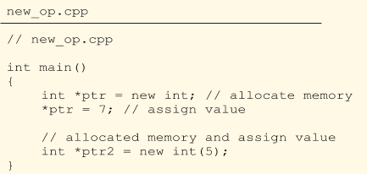
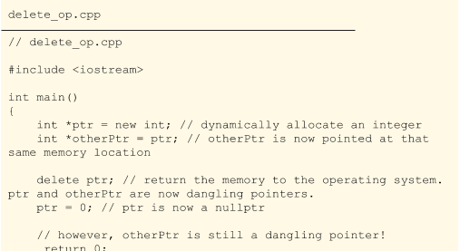

Slide 10
Dynamic Arrays
To allocate an array dynamically we use array form of new and delete
(new[ ] , delete[ ])

Slide 11
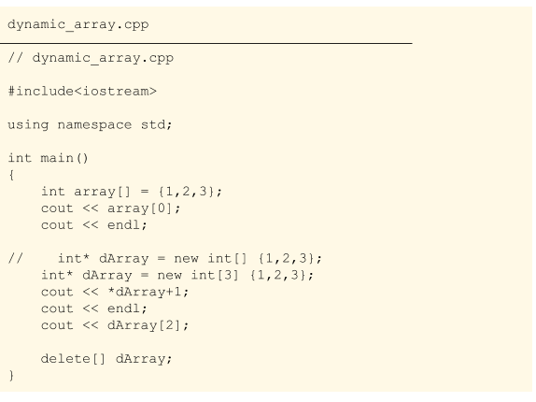

Slide 12
Safe Array
This is a type of the array that ensures to handle the error of index out of bounds. This is done by overloading the subscript [ ] operator.

Slide 13
// Implementation of [] operator. This function must return a // reference as array element can be put on left side int &Array::operator[](int index) { if (index >= size) { cout << "Array index out of bound, exiting"; exit(0); } return ptr[index]; }

Slide 14
Jagged Array
This is also referred to as an Array of pointers or Array of arrays. This is a multidimensional with different sizes.

Slide 15
int *weekArray[7] weekArray[0] = new int[3]; // expenditures for Sunday weekArray[1] = new int[5]; // expenditures for Monday etc. weekArray[0][0] = 7; weekArray[0][1] = 17; weekArray[0][2] = 23; // Sunday weekArray[1][0] = 5; weekArray[1][1] = 10; etc. // Monday delete [] weekArray[0]; delete [] weekArray[1]; etc.

Slide 16
Rule of Three
If you need to explicitly declare either the destructor, copy constructor or copy assignment operator yourself, you probably need to explicitly declare all three of them.

Slide 17
struct Node { char *name; int age; Node(char *n = "", int a = 0) { name = strdup(n); age = a; } }; Node node1("Roger",20), node2(node1); strcpy(node2.name,"Wendy"); node2.age = 30; cout<<node1.name<<' '<<node1.age<<' '<<node2.name<<' '<<node2.age; | Node(char *n = 0, int a = 0) { name = strdup(n); age = a; } Node(const Node& n) { // copy constructor; name = strdup(n.name); age = n.age; }
 | Node& operator=(const Node& n) { if (this != &n) { // no assignment to itself; if (name != 0) free(name); name = strdup(n.name); age = n.age; } return *this; }

Slide 18
Task:1
Create a Program to solve Quadratic Equation and Calculate the roots.
Your program must implement a class Quadratic Equation.
You must use header files for class implementation.

Slide 19
Task:2
Create a program containing information for a Student.
A Student can have the following information
ID
Batch
Discipline
Expected Graduation Year
Current Courses (this can be an array of strings)
Use Dynamic Safe Arrays to store the information of multiple students.

Slide 20
Task:3
Implement a class for a Car. Implement Rule of Three for this class.
A car can have properties of another car. (same category cars).
Using copy constructor.
Using Assignment Operator.
A car object should be destroyed properly. Using destructor.

